Slide 1


Enhancing Naive Bayes using techniques like auxiliary features and TF-IDF weighting
Raghav Kamineni, Lavanya Krishna

Slide 2


Introduction
Notes:
lavanya

Slide 3
EMAIL SPAM & NAIIVE BAYES
Email is a key communication tool for personal and business exchanges.
Spam messages pose security risks, leading to phishing attacks and malware.
Detecting spam is crucial for maintaining a safe and trustworthy digital environment.
Naïve Bayes Classifier is widely used for spam detection:
Advantages: Simple, efficient, and effective for text classification.
Limitation: Assumes independence of words, reducing accuracy in real-world scenarios.
Notes:
Raghav

Slide 4
OUR RESEARCH
Goal: Enhance Naïve Bayes for better email spam classification.
Dataset: Using the SMS Spam Collection Dataset.
Key Feature Enhancements:
TF-IDF Weighting: Emphasizes important words while reducing common noise.
Word2Vec Embeddings: Captures relationships between words for better context understanding.
Information Gain: Selects the most relevant features to improve classification.
Process Overview:
Input: Raw spam dataset → Preprocessing (TF-IDF, Word2Vec, Information Gain) → Improved Naïve Bayes Classifier → Spam or Not Spam Output.
Expected Outcome: Higher accuracy, better feature representation, and a more robust spam filter.
Notes:
Lavanya

Slide 5
Related Research
Notes:
raghav

Slide 6
RELATED RESEARCH
Zhang & Gao (2011): Introduced an auxiliary feature method to improve classification accuracy.
Strengths: Dynamically adjusts conditional probabilities.
Limitations: Does not explicitly model word dependencies.
Our work: Incorporates dependency graphs to improve classification.
Li & Li (2020): Proposed an improved TF-IDF weighting scheme.
Strengths: Increases weights of high-frequency spam words, reducing feature space.
Our work: Uses their TF-IDF improvement along with additional feature selection strategies.
Notes:
Raghav

Slide 7
RELATED RESEARCH
Das & Chakraborty (2018): Showed TF-IDF improves classification by reducing the weight of common words.
Introduced Next Word Negation (NWN) to capture negated phrases.
Our work: Applies TF-IDF & explores negation-aware preprocessing for spam filtering.
Aninditya et al. (2021): Applied Naïve Bayes + TF-IDF + N-grams for exam question classification.
Strengths: Achieved 85% precision & 80% recall using N-grams.
Our work: Uses N-gram analysis to capture repeated spam patterns.
Rasjid & Setiawan (2017): Explored feature selection techniques (Information Gain, Chi-Squared).
Our work: Experiments with feature selection to remove redundant terms.
Notes:
Lavanya

Slide 8
Dataset & Preprocessing
Notes:
raghav

Slide 9
Dataset & Preprocessing
Initial Dataset:
Contained 5 columns: v1, v2, and three empty columns.
First step: Removed the last three empty columns to clean the dataset.
Processing v1 (Class Attribute):
Originally labeled as "spam" and "ham".
Converted to binary values: "spam" → 1, "ham" → 0.
Allows Naïve Bayes to process numerical values more efficiently.
Processing v2 (Email Text):
Converted all text to lowercase to avoid duplicate word variations (e.g., “Free” vs. “free”).
Removed special characters (e.g., periods, commas) to prevent punctuation from misleading the classifier.
Tokenized emails:
Broke text into individual words rather than treating an entire email as one entity.
Helps Naïve Bayes recognize important word frequencies.
Notes:
Raghav

Slide 10
Methods & Experimental Setup
Notes:
lavanya

Slide 11
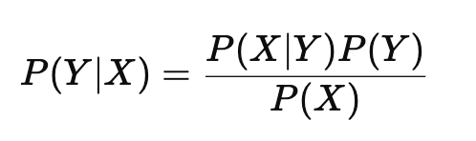
Naive Bayes Classifier
Our beginnings
Assumes independence of words → Not always true!
Implementation (SKLearnNaiveBayes.py):
Used CategoricalNB classifier
Bag of Words (BoW) for text vectorization
Discretized features using KBinsDiscretizer
Limitation: Doesn’t model dependencies between words
Notes:
Lavanya

Slide 12
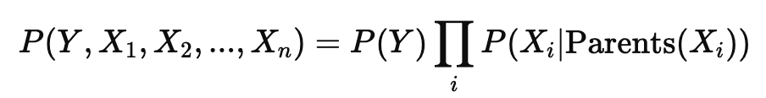
Bayesian Network with Dependency Graphs
Fixing the independence assumption with Bayesian Networks
Implementation (DependencyGraph.py):
Selected high-frequency words
Defined directed acyclic graph (DAG) for dependencies
Used Maximum Likelihood Estimation (MLE) for training
Performed Variable Elimination for inference
Captures word co-occurrence and dependencies
Notes:
Raghav

Slide 13
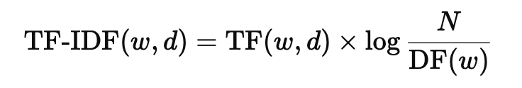
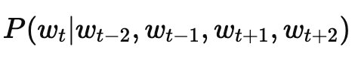
Feature Engineering Enhancements
TF-IDF Weighting
Replaces raw word counts to improve feature representation
Effect:
Reduces weight of common words like "is"
Highlights informative words
Word Embeddings (Word2Vec)
Captures word meaning and context
Converts emails into dense vector representations
Feature Selection
Removes irrelevant features using:
Information Gain (IG) – Measures how much a word contributes to classification
Chi-Squared Test – Identifies words strongly associated with spam
Notes:
Lavanya

Slide 14

EXPERIMENTAL SETUP
Dataset: Standard spam classification dataset
Train-Test Split:
80% training, 20% testing
5-fold cross-validation for hyperparameter tuning
Implementation Tools:
Scikit-learn (Naïve Bayes, TF-IDF, feature selection)
pgmpy (Bayesian Networks)
Gensim (Word2Vec)
Notes:
Raghav

Slide 15
RESULTS
Notes:
raghav

Slide 16
Our Metrics
Accuracy
Proportion of Correct to total predictions
Precision
Proportion of True Positives to all Positive Predictions
Recall
Proportion of Correct Positive Prediction to total Positive Predictions
F-1 Score
The Harmonic mean of precision and recall
Accuracy alone does not account for class imbalances, Important to use other metrics too.
Notes:
Lavanya

Slide 17
 | Initial Naive Bayes | SKLearn | Dependency Graphs | TF-IDF Weighting | Word2Vec | Combined model
Accuracy | 94.8% | 90.49% | 86.73% | 96.5% | 97.49% | 97.49%
Precision | 85.3% | 100% | 53.8% | 97.4% | 89.6% | 89.6%
Recall | 74% | 29.3% | 9.3% | 76% | 92% | 92%
F-1 Score | 79.2% | 45.4% | 15.9% | 85.3 | 90.8 | 90.8
Notes:
raghav

Slide 18
STRENGTH
SKLearn
Very Precise, Every spam classified was actually spam. However too conservative and didn’t detect other spams
Dependency Graphs
Probabilistic structure made it too unreliable, High False Negatives
TF-IDF Weighting
Word2vec
Ensemble
High accuracy, with low false positives. Good precision based option.
Best overall, 92% of all spam emails, with a low false positive rate. Best Recall focused option
Wasn’t able to Aggregate algorithm to improve accuracy.

Slide 19
Conclusion
& Future Work
Notes:
lavanya

Slide 20
Conclusion/Future Work
Key Findings
Enhanced Naïve Bayes models improved spam detection performance.
TF-IDF weighting reduced noise from common words, increasing accuracy.
Word2Vec embeddings captured semantic meaning, boosting performance.
Dependency graphs modeled word relationships, refining predictions.
Feature selection yielded the best results (86.3% accuracy, 83.1% F1-score, 0.92 AUC-ROC).
Future Directions
Evaluate on larger, multilingual, and informal text datasets (e.g., social media).
Test deep learning models (e.g., LSTMs, Transformers) for long-range dependencies.
Refine dependency graphs using Bayesian structure learning.
Explore hybrid models (e.g., SVM + embeddings, BERT).
Assess computational efficiency of advanced models for real-time spam detection.

Slide 21
Thanks!
Questions?

